Slide 1

Epidemiology

Slide 2
Contents
Concept – Fundamentals, Definitions & approach
Measurement – Mortality, morbidity, Rate & ratio
Health research – Research question, sampling, methodology
Association and causation
Descriptive Epidemiology
Analytical and experimental design
Association and causation
Investigation of epidemic
Screening
Infectious disease policy
Cold chain

Slide 3
Epi (upon) Demos (population) logos (scientific study)
Definition - The study of the occurrence and distribution of health-related events, states, and processes in specified populations, including the study of the determinants influencing such processes, and the application of this knowledge to control relevant health problems
Study of
Disease Frequency
Disease distribution
Determinants

Slide 4
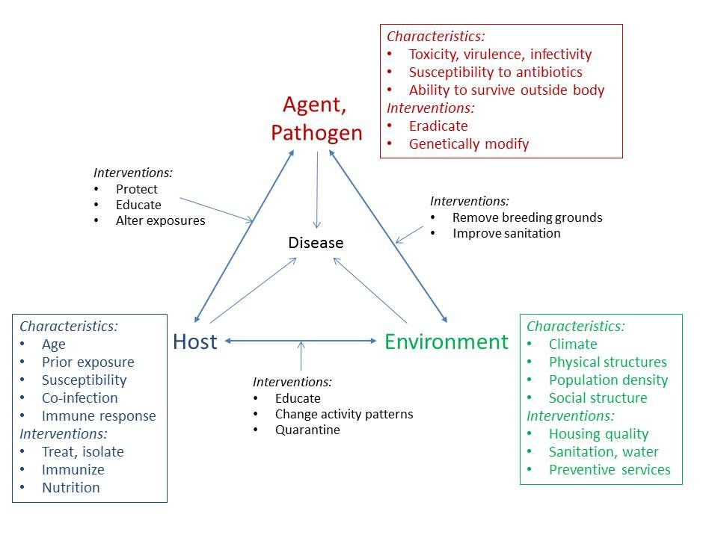
Epidemiological triad

Slide 5
Aim
To describe the distribution and magnitude of health and disease problems in human populations
To identify aetiological factors (risk factors) in the pathogenesis of disease
To provide the data essential to the planning, implementation and evaluation of services for the prevention, control and treatment of disease and to the setting up of priorities among those services.

Slide 6
Epidemiology vs clinical medicine
Epidemiology
Clinical medicine
Unit – population / population at risk
Quantitative tool for community diagnosis
Considers all factors which causes disease
Form assumptions and hypothesis
Helps in public health policy formulation
Quantitative and qualitative science.
Epidemiologist went to community
Case or cases
LAB TEST FOR DIAGNOSIS
Specific treatment
Patient comes to the clinician

Slide 7
Epidemiological Approach Asking Questions & Making Comparisons
Health Action
Health Event
What can be done to reduce this problem and its consequences ?
How can it be prevented in the future ?
What action should be taken by the community ? By the health services? By other sectors ? Where and for whom these activities be carried out ?
What resources are required ? How are the activities to be organized ?
What difficulties may arise, and how might they be overcome ?
What is the event ? (the problem)
What is its magnitude?
Where did it happen?
When did it happen?
Who are affected?
Why did it happen?

Slide 8
Measurements in Epidemiology
Measurement of mortality
Measurement of morbidity
Measurement of disability
Measurement of natality
Measurement of the presence, absence or distribution of the characteristic or attributes of the disease
Measurement of medical needs, health care facilities, utilization of health services and other health-related events
Measurement of the presence, absence or distribution of the environmental and other factors suspected of causing the disease
Measurement of demographic variables.

Slide 9
Tools of measurement
Rate
A rate measures the occurrence of some particular event (development of disease or the occurrence of death) in a defined population during a given time period.
Types – Crude, Specific, Standardized
Ratio
It expresses a relation in size between two random quantities. The numerator is not a component of the denominator. The numerator and denominator may involve an interval of time or may be instantaneous in time.
Proportion
A proportion is a ratio which indicates the relation in magnitude of a part of the whole. The numerator is always included in the denominator. A proportion is usually expressed as a percentage.
Notes:
Crude rates: These are the actual observed rates such as the birth and death rates. Crude rates are also known as unstandardized rates.
Specific rates: These are the actual observed rates due to specific causes (e.g., tuberculosis); or occurring in specific groups (e.g., age-sex groups) or during specific time periods (e.g., annual, monthly or weekly rates).
Standardized rates: These are obtained by direct or indirect method of standardization or adjustment, e.g., age and sex standardized rates

Slide 10
Numerator & Denominator
Numerator refers to the number of times an event (e.g., sickness, birth, death, episodes of sickness) has occurred in a population, during a specified time-period. The numerator is a component of the denominator in calculating a rate, but not in a ratio.
Denominator refers to the lower portion of a ratio. Numerator has little meaning unless it is related to the denominator. The epidemiologist has to choose an appropriate denominator while calculating a rate. It may be
(a) related to the population
Mid – year population, Population at-risk, person time, person distance, sub – groups of the population
(b) related to the total events.
Notes:
In some instances, the denominator may be related to total events instead of the total population, as in the case of infant mortality rate and case fatality rate. In the case of accidents, the number of accidents “per 1000 vehicles” or “per million vehicle-miles” will be a more useful denominator than the total population, many of them may not be using vehicles.

Slide 11
Minimum information required by public health specialist
General Information – Location, governmental and societal pattern, geographical features, transport, communication, climate
Socio-demographic – population size, age & sex constitution, fertility indicators, growth rate, education, occupation
Morbidity and Mortality – Maternal mortality rate & Infant mortality rate
Health related indicator – water supply, sanitation, housing pattern
Health services – location, government & non – government, availability, equipment
Preventive / promotive health program

Slide 12
Sources - Census
Census “to enumerate”
Sequence of activities concerned with collection, collation and factual presentation of data pertaining to social, demographic, and health related factors in respect of a nation, undertaken periodically, and having some sort of legal provision for it to be undertaken
Size & composition of a population, forces determining it, trends anticipated in future, population density, literacy rate, economic conditions, occupational characteristics & indicators of mortality
Periodicity – 10 year,
Types – De facto (location at the time of enumeration), De jure (usual place of residence)

Slide 13
Sample surveys
Sample registration system (SRS)
8853 sample units (set of villages (4961) and urban blocks(3892))
Double recording method – part time enumerator (school-teacher / anganwadi worker), official from SRS dept (once 6 months)
Annual / half yearly reports – birth rate, death rate, population annual growth rate, IMR, fertility indicators
National Sample Survey (NSS)
Annual basis, - one particular aspect of social, demographic or health issue in particular survey
Reproductive health Survey (RHS) & Facilities Survey (FS)
Ongoing components of RCH
National Family Health Survey (NFHS)
➔ valuable information for planning / evaluation of health services / programs
➔ for identifying community needs
➔ for providing information about available health manpower and other resources regarding risk factors
➔ providing statistics for public health / nutritional programs

Slide 14
Vital statistics and Civil registration system
Birth, Death– continuous, permanent and compulsory recording
Under Registrar general of India (Ministry of Home Affairs)
Death Certificate
Part I
Disease / Condition leading to death – Pulmonary embolism
Due to / as a consequence of – Pelvic Vein thrombosis
Due to / as a consequence of – Septic abortion
Part II
Other significant conditions contributing to death but not related to the disease causing it – NIDDM
Birth Certificate
Denominator data for IMR, MMR
Information – date, place of birth, domiciliary / institutional birth, sex of newborn, details of parent, birth attendant’s detail, type of delivery, complications, if any; age of mother, birth order

Slide 15
Disease notification and registration
National and International disease notification
Disease registries
Epidemiological surveillance data
Information from specific population
Records of hospital and health services

Slide 16

Thanks

